Slide 1

Financial Transaction Request Training
(Abridged Version)
Student Organization Finance Office
Fall Business Manager Training 2026
Notes:
HANNAH
Hi Everyone, my name is Tina Muller, I am the Manager of Finance for the Department of Student Activities and I am a secondary advisor for SAAC.
Today I am going to walk you through how to transact in the SOFO office for the current year. The Financial Transaction Request or FTR is the process that you will use to do any financial transactions for your student organization. There is a video located on sa.Rochester.edu with step by step instructions on how to complete the Financial Transaction Request form, and also a quiz that must be passed by the Business Manager of each organization, with a 75% or higher.
New this year, we are welcoming the business managers from our Fraternity and Sorority organizations. FSA organizations will now also be using the FTR form to process financial transactions. So for individual Fraternity and Sorority organizations, and also organizations considered to be Agency groups, all of the information I am reviewing may not pertain to everything you do. But bear with me, because everyone needs to know how to complete the FTR since all groups are eligible for Supplemental Funding, like Kaitlyn just went over. If your group is approved for Supplemental Funding, then you would need to complete the FTR in order to access those funds.
Please note, for all business managers!! When you take the Business Manager quiz, you do NOT need to worry about the scoring. You only need to know if you passed or not. The scoring points will not make sense, (a quirk with CCC) but what is most important is if you get the PASSED notification. Ok, let’s get started!

Slide 2

What is SOFO?
Student Organization Finance Office
Where Business Managers can initiate transactions, access funds, or ask questions related to their SAAC budget or SOFO account.
We cannot process transactions for Student Organizations that do not have an open account with SOFO.
Financial Transaction Request Training Business Manager Training 2026
Notes:
HANNAH
As Kaitlyn mentioned previously, SOFO is the Student Organization Finance Office.
It is where you, as business managers, can initiate transactions and access funds that have been allocated to your student organization.
SOFO does not process transactions for organizations that do not “bank” with us. So if your organization has funds in an outside bank account, we can not access those funds
and we can only process transactions for funds that reside in open SOFO accounts, or in the case of FSA groups, other accounts within the U of R.
Business Managers are the only e‐board members who can initiate transactions with the FTR, and every organization must have a Business Manager identified on their CCC page.
An exception form would need to be completed and approved prior to someone other than the Business Manager initiating a transaction with SOFO. Exceptions may be granted in extenuating circumstances and will be approved on a case-by-case basis. If an exception is granted, the person who wants to transact also needs to complete the business manager quiz.

Slide 3
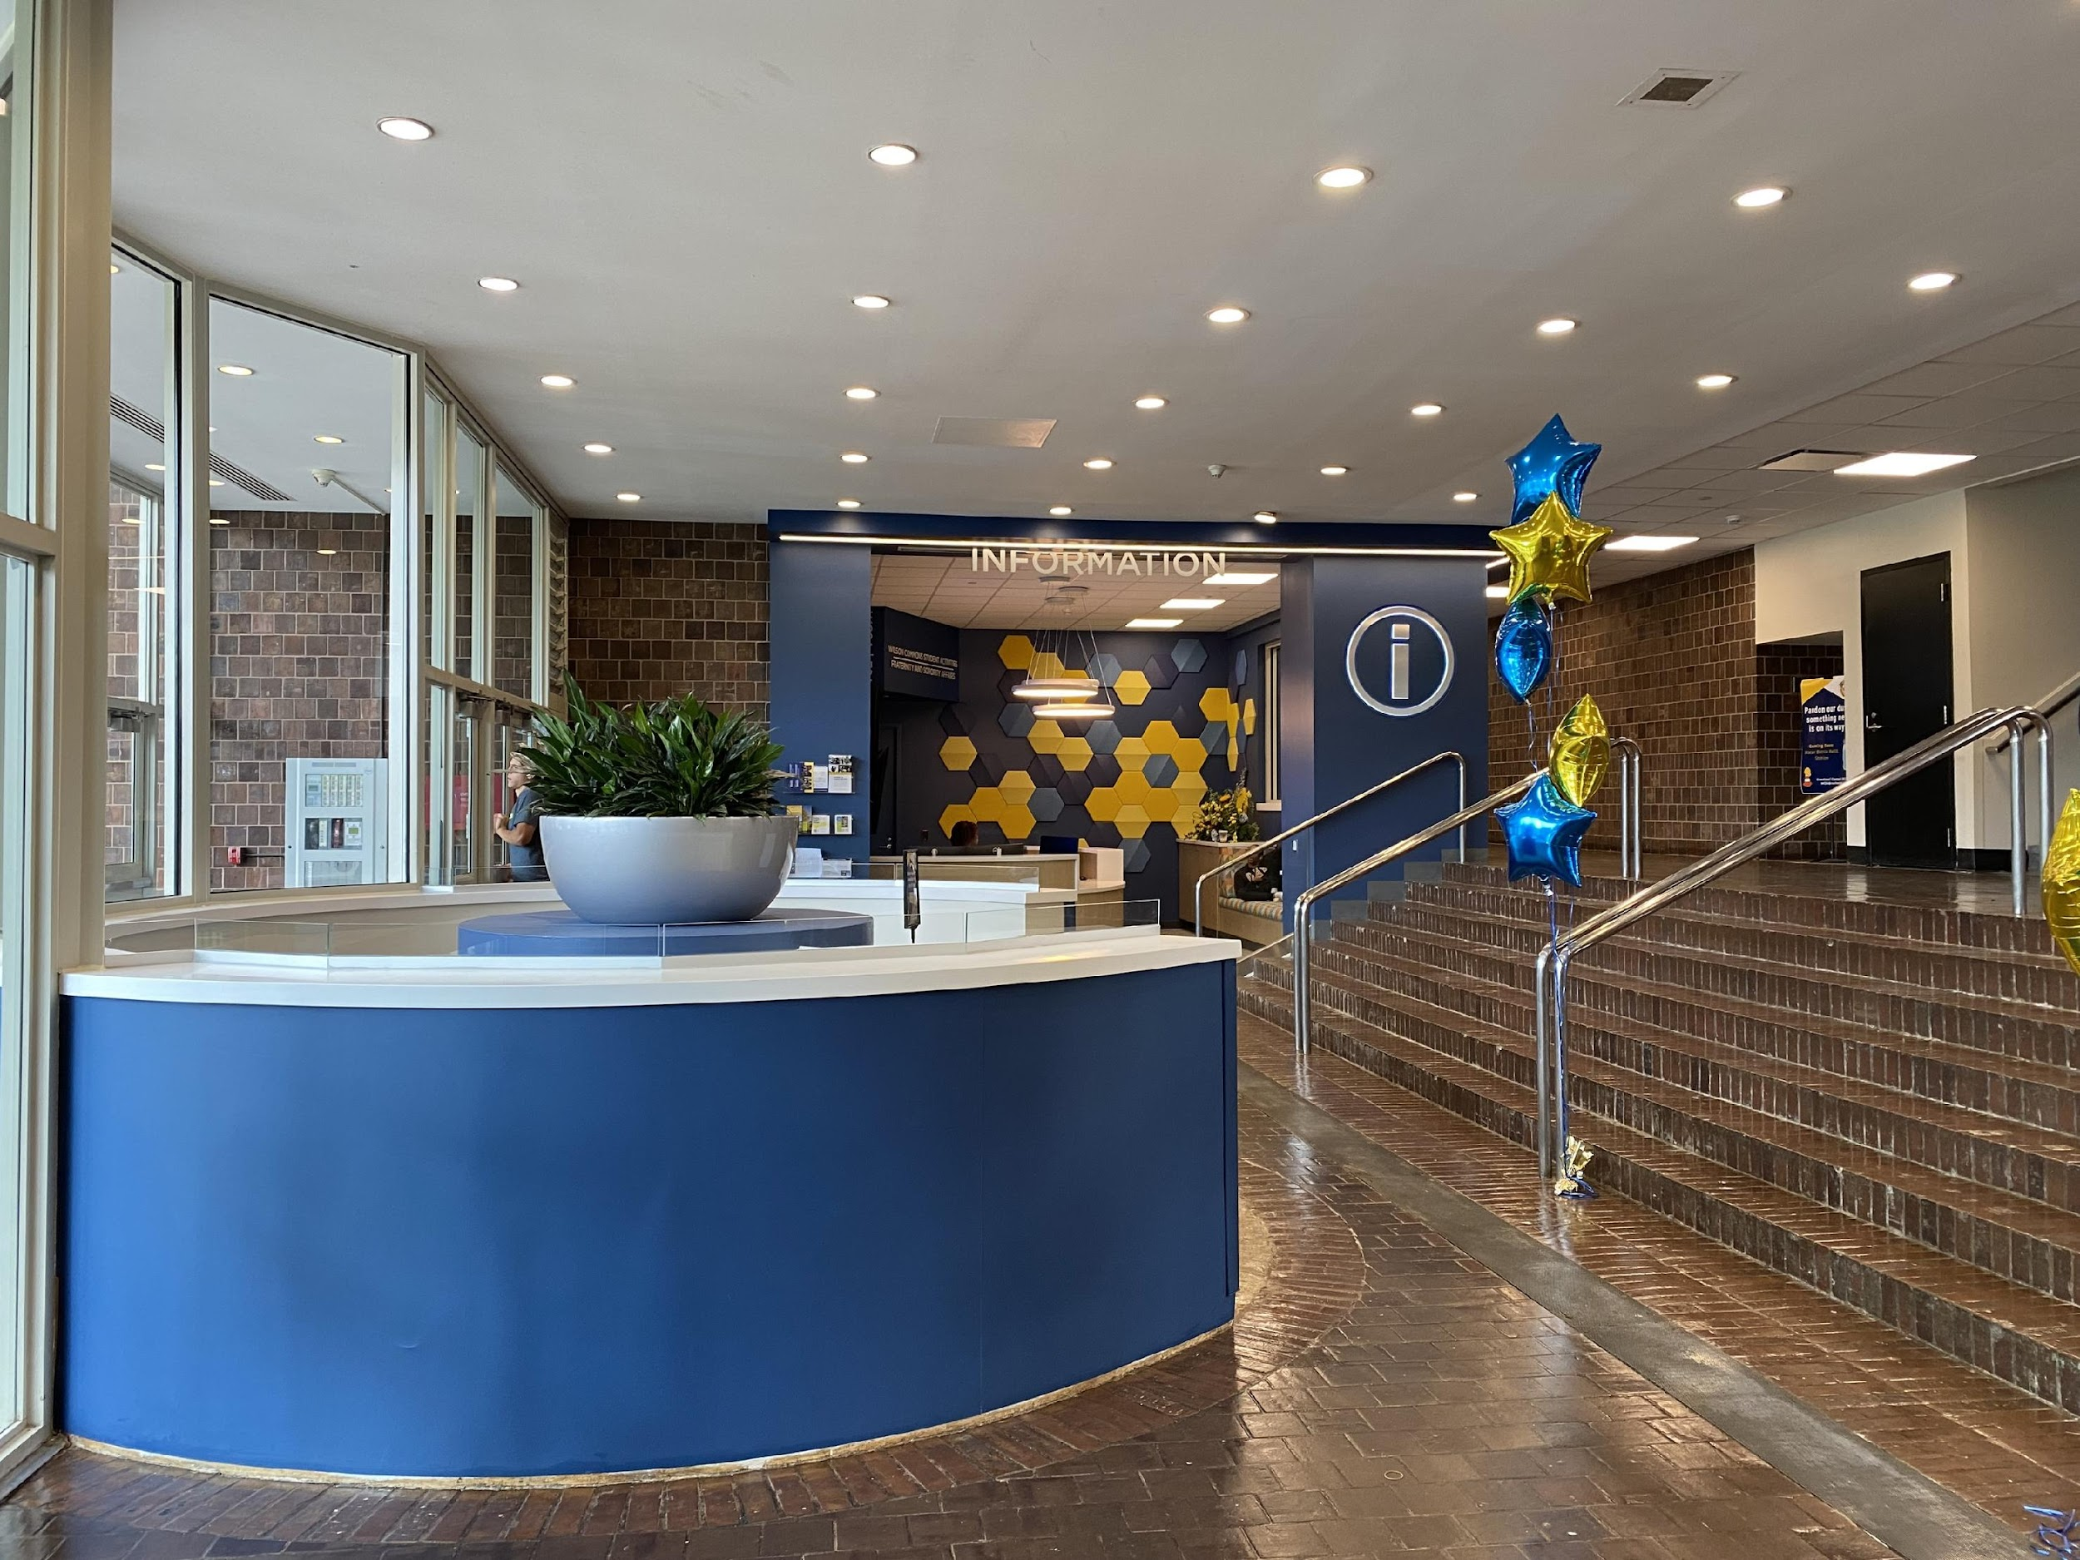
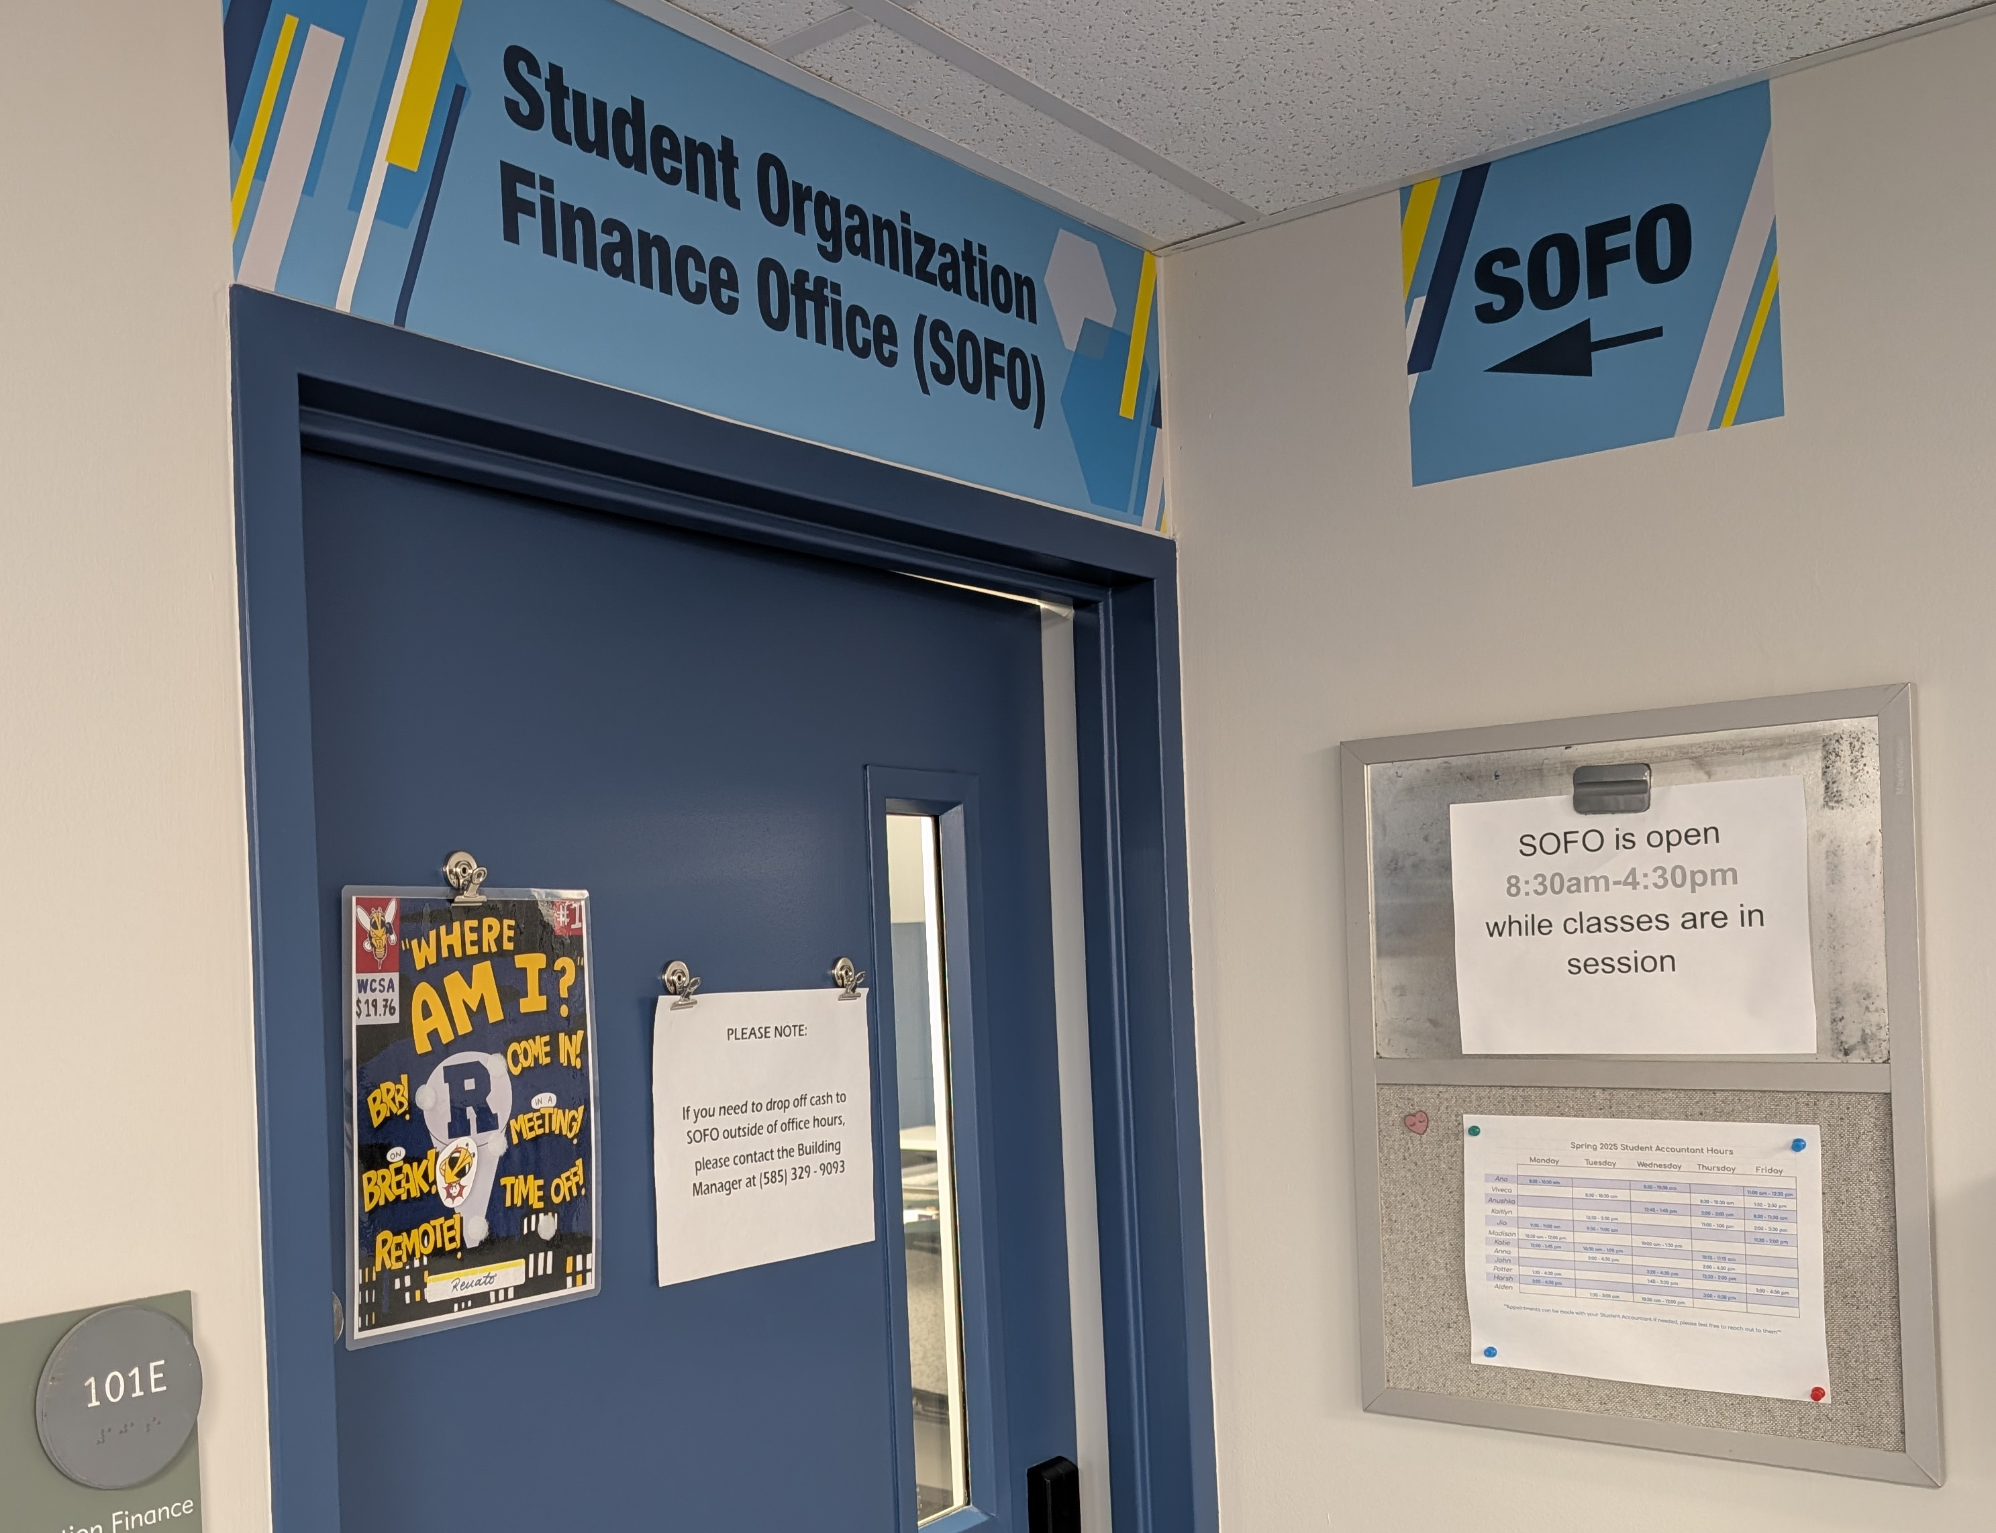
Where is SOFO & when is it open?
Room 101E Wilson Commons
Down the spiral staircase, inside the Ruth Merrill Center (and across from the Common Market and Shops @ Wilco)
Monday – Friday
8:30 am – 4:30 pm*
the office is typically closed on Federal Holidays
Financial Transaction Request Training Business Manager Training 2026
Notes:
HANNAH
SOFO is located within Wilson Commons on the first floor. The office is behind the Spiral Staircase in the back left Corner of the Ruth Merrill Center.
For Fraternity and Sorority specific questions, you can see Kristen Miller, who is located in the 201 Suite, located on the other side of the Campus Information Center.
SOFO is open Monday – Friday 8:30 am – 4:30 pm, the office door is typically open and staffed with student accountants and professional staff, unless otherwise noted. The SOFO office will not be open on Federal Holidays. So we will not be open next Monday, which is Labor Day.

Slide 4
How do I contact SOFO?
Start with…
Your assigned Student Accountant. Give them some time to respond.
If that doesn’t work…
Email askSAAC (askSAAC@rochester.edu) – Checked by Hanna and Anthony
Still no response?
Contact the Student Activities general email (Student.Activities@rochester.edu)
Financial Transaction Request Training Business Manager Training 2026
Notes:
HANNAH
To reach SOFO, the best place to start would be with your designated Student Accountant.
Student Accountants can be reached during their designated Office hours in SOFO or by e‐mail and may be able to arrange alternative times to meet to discuss questions that you may have.
If for some reason you do not receive a response to your e‐mails within a reasonable timeframe (which is around 1‐2 business days), please feel free to copy the Treasurer, Deputy Treasurer, into your email correspondence.
Our goal is to always assist you in a timely manner, but we do receive a large number of inquiries.

Slide 5
Who works in SOFO?
Student Accountants: List with office hours is posted online at SA.Rochester.edu (Subject to Change)
Deputy Treasurer – Viveca Schreiner
SA Treasurer – Anna Fang
Student Activities Staff Members
  Hannah Endeshaw – located in 101E
  Anthony McDaniel – located in 101E
Financial Transaction Request Training Business Manager Training 2026
Notes:
HANNAH
SOFO is made up of Student Accountants, the Treasurer, Deputy Treasurer and Professional Staff Members. The updated list of Student Accountants, their categories and their office hours is posted on the sa.Rochester.edu website.
Introduce staff here!

Slide 6
What Transactions can SOFO do?
Online Orders and Copy Center order placement
Credit Card and Purchase Order pick up for local vendors
Payment of internal U of R Vendors (including ECM, Meliora Catering, Facilities, Sanitarian, etc.)
Payment of invoices and contracts for external vendors by check
Purchase Order requests
Accept cash and check deposits for student organizations
Everything in white starts with the Financial Transaction Request form and the item in Blue starts with a deposit ticket.
Financial Transaction Request Training Business Manager Training 2026
Notes:
Any of the transactions listed on the screen can be processed by SOFO:
Online Orders and Copy Center order placement
Credit Card pick up for local vendors
Payment of internal U of R Vendors (including ECM, Meliora Catering, Facilities, Sanitarian, etc.)
Payment of invoices and contracts for external vendors by check
Purchase Order requests
Accept cash and check deposits for student organizations.
Everything in white starts with a FTR form and the item in Blue starts with a deposit ticket. I will be reviewing some of these transaction types briefly in this part of the training.

Slide 7
Financial Transaction Request
(FTR) Form timeline
The Financial Transaction Request (FTR) Form can take 2-3 business days to be fully processed. Please submit them in a timely manner.
Do not wait until the last minute
FTR form can be found in CCC and at https://sa.rochester.edu/sa/business-manager-tools/
Financial Transaction Request Training Business Manager Training 2026
Notes:
Please remember that Financial Transaction Request forms can take 2-3 business days to be fully processed.
For example: you cannot submit an FTR on a Thursday and expect to pick up a credit card on Friday!
Also, this doesn’t mean 2-3 days before your event, or 2-3 days shipping time. If you have an event on a Friday, and you submit an FTR for an on-line order the Tuesday before, your items will not arrive in time for your event. Please plan ahead, especially with on-line orders, and submit forms in a timely manner.

Slide 8
Transaction Type – Online or CC Purchase
Do you have an order you would like to place online?
If you answered “YES” to this question you can select Online or Credit Card Purchase as your payment method.
This selection will trigger logic to ask additional questions related to online purchases.
Financial Transaction Request Training Business Manager Training 2026
Notes:
Do you have an order you would like to place online?
Examples of vendors that might fall under this category are:
Amazon
Panera Bread
Enterprise Rental Car
BJ’s
Copy Center requests
If this is your request, how would you like the order placed? Would you like someone to order it on your behalf, or would you like to set up a time to meet with someone to place the order?
If you select Yes, please place this order on my behalf and do not provide the links and quantities of the items you would like ordered; your form will be sent back to you for edits. Keep watching the chat of the FTR form submitted to see if more information is needed from you. Sometimes the item you requested to order is no longer available. The accountant will reach out in the chat of the FTR to find out what to do in that case.
Please remember – we are asking groups to make an appointment to come to order pizza for your General Interest Meetings. We order an extremely large quantity of pizza, especially at the beginning of each semester. By coming in, to place the order with the accountant, we will make sure that it is delivered to the correct location on campus and hopefully avoid miscommunications with the pizza vendors.

Slide 9
Transaction Type – Online or Credit Card Purchase
Hotel Reservations
Organizations that have received approval to travel and require a hotel stay can use the SOFO Lucid travel link: https://rochester.lucidhotels.us/
A video from Lucid Travel is posted on the sa.rochester.edu website with more information.
Once the FTR form has been approved, hotel reservations using the link above can be processed by the Business Manager outside of SOFO and do not require assistance from SOFO.
*FTR forms for travel will not be processed until the Activity Registration is started!*
Financial Transaction Request Training Business Manager Training 2026
Notes:
Organizations that have received approval to travel and require a hotel stay can use the SOFO Lucid travel link indicated: https://rochester.lucidhotels.us/.
Once the FTR form has been approved, hotel reservations using the link above can be processed by the Business Manager outside of SOFO and do not require assistance from SOFO, OR they can be placed in person with an accountant. This link is particular to us, and you should see the U of R Logo in the corner of that screen when you make a reservation. That’s how you know you are on the right page. It is very important if you are making hotel reservations that you read all the amenities with each particular hotel. Sometimes they require at least 1 person to be over the age of 21. I would suggest that you make an appointment with your student acct to do your first hotel reservation so you understand the process.
There is also a video from Lucid Travel that is posted on the sa.rochester.edu website with step-by-step directions on how to make those reservations. All hotel reservations must go through Lucid Travel. If your organization wants to make a reservation outside of Lucid travel, an exception form should be submitted.

Slide 10
Transaction Type – Check
Do you have an Invoice or a fully executed (signed) contract from a NON-UR vendor?
If you answered “YES” to this question you can select Check as your payment method.
**If you are paying an individual, a completed W-9 must be submitted with the invoice or contract**
Financial Transaction Request Training Business Manager Training 2026
Notes:
For payment of invoices and contracts, please use the Check transaction type in the drop-down menu on the FTR form.
Checks will be issued twice per week; currently, they are scheduled for Tuesdays and Fridays. Please be sure to plan accordingly, keeping the 2-3 day processing time in mind.
In order to process payment to an individual service provider we must receive a completed and signed W‐9 form, which provides us with their Tax Id so that a 1099 tax form can be issued by the University for tax implications, if necessary.

Slide 11
Transaction Type – Check cont.
Contract
A Service/Performance Agreement must be used (instead of an invoice) for Services provided by an Individual or Business. A completed W-9 must be provided with the fully executed contract.
  Examples of Services include but are not limited to:
    Photographer or Videographers
    DJ’s
    External Caterers
Contract must be signed by the Service Provider and the U of R’s Authorized signer (not a member of your e-board).
  Please work with your advisor to obtain the required signatures
Financial Transaction Request Training Business Manager Training 2026
Notes:
Student Organizations that intend to pay someone for services provided, (which may include services like photography, Dj’s, etc.) they must use the WCSA’s Standard Agreement Form. This includes External Caterers for large dinner events. If the event is considered a Large Event, on the 30-day timeline, then you will most likely need to submit a service agreement for the caterer as well.
Work with your Advisor on this. Questions regarding the necessity of a Contract or Standard Agreement form can be directed to your advisor as well.

Slide 12
Transaction Type – Credit Card Sign Out
Wegmans
Sunoco (gas card)
Home Depot
Credit Cards can be signed during SOFO office hours by the Business Manager. Credit Cards must be returned by end of day the following business day or a $5 late fee will be assessed per card per day.
Financial Transaction Request Training Business Manager Training 2026
Notes:
SOFO has credit cards for the vendors listed on this slide, and they can be signed out during SOFO office hours by the Business Manager. Credit Cards must be returned by end of day the following business day or a $5 late fee will be assessed per day.
For example, if a credit card is signed out on a Monday, it must be returned by Tuesday at 4:30 pm. If a credit card is signed out on a Friday, it must be returned by Monday at 4:30 pm.
**Credit Cards MUST always be returned with a receipt** Please remember if these timelines are not followed, it will reflect negatively on your organization’s SOAR report.

Slide 13
Credit cards MUST be returned with a receipt

Slide 14
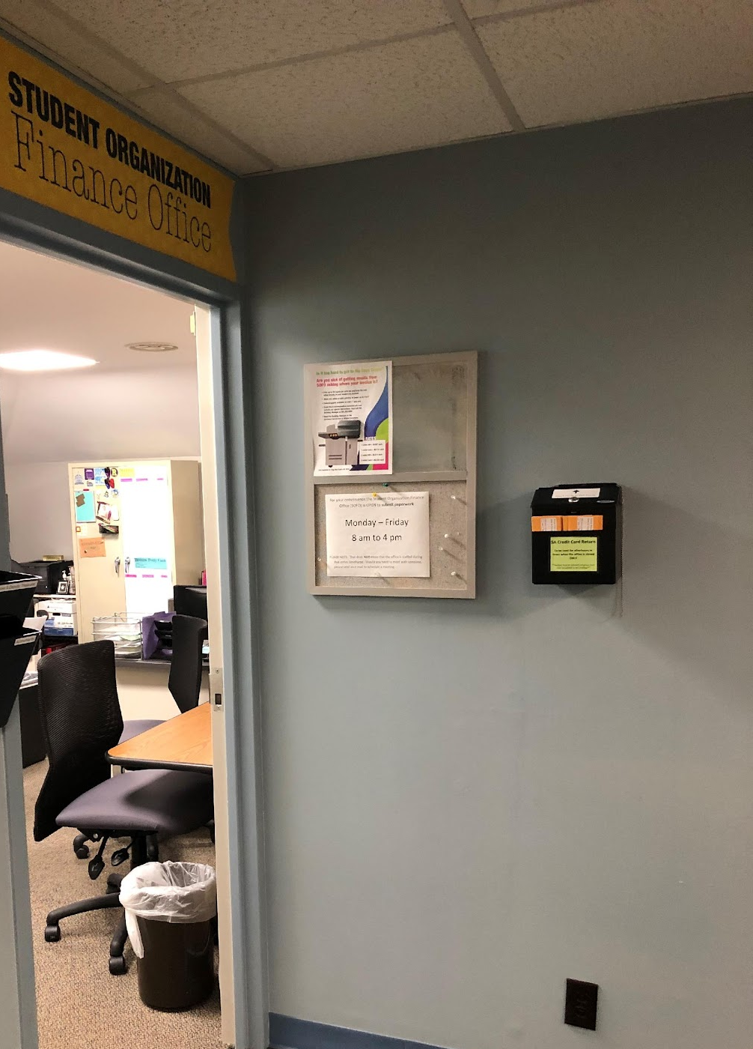
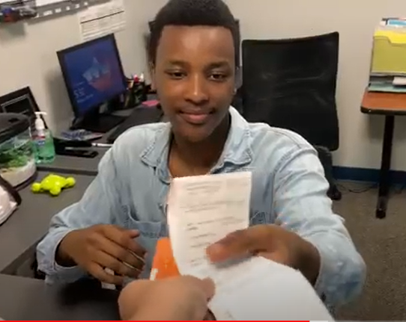
Credit Card Drop Off
Credit Cards (and receipt) can be dropped in the Credit Card drop off outside of the SOFO office door
Credit Cards and receipts can be left with a SOFO employee in the office
Financial Transaction Request Training Business Manager Training 2026
Notes:
Credit Cards and receipts can go in the Credit Card Drop box outside the SOFO office door or can be left with a SOFO employee in the office.
They should never be placed in a mailbox or any other container.

Slide 15
Transaction Type – Purchase Order
Issued when a NON-UR vendor provides a quote and they have indicated that they can not start production/your order until they have received a Purchase Order (promise to pay).
A PO will be generated by SOFO and can be retrieved from the SOFO office.
** Once the invoice is received, please submit a new FTR Form and reference the PO # in the description**
Financial Transaction Request Training Business Manager Training 2026
Notes:
As mentioned previously, if a NON-UR vendor provides your group with a quote – often they are looking for a Purchase Order, which is consider a “promise to pay”. We can issue the Purchase Order so that they can start production of your order and then we issue the check once the final details of the order have been finalized.

Slide 16
Transaction Type - Purchase Order sign out
International Food Market
Joy Mart (located in College Town)
Tandoor of India (GIMs only)
Purchase orders can be picked up during SOFO office hours by the Business Manager.
**Again, all receipts for Purchase Orders MUST be returned the next day**
Financial Transaction Request Training Business Manager Training 2026
Notes:
SOFO has set up arrangements with a few local vendors who have agreed to accept a Purchase Order as payment instead of a credit card. Those businesses are located on this slide.
Purchase orders can be picked up during SOFO office hours by the Business Manager. You would then take the PO to the local vendor and present it at the register to pay. They will take a copy and give you a receipt. Receipts for the purchase order must be returned by end of day the following business day, just like the credit cards that are signed out. We would then make payment to those vendors based on the receipts submitted.

Slide 17
Payment by Check vs Purchase Order
Invoice or Fully Executed contract has been received from Vendor.
Check request via FTR form
External Vendor has (or plans to) provide services or goods
Vendor has not provided an invoice but would like a “promise” to pay before they will begin processing order.
Purchase Order request via FTR form
Once Vendor sends Invoice
Notes:
I’m now going to talk through a few of the TRANSACTION TYPES that you will select when completing the FTR. Again, step-by-step instructions are available in the FTR training video. This slide talks about the difference between a check and a purchase order:
The major difference between the two is whether the word Invoice or Quote appears on the documentation. If the document says Invoice, you would submit the FTR and select Check as the transaction type.
If the document says Quote on it, we can not issue a check until it is converted from a Quote to an invoice.
In general, the purpose of a quote is that the vendor is indicating to your organization that they anticipate the cost for their services to be X… this means that the amount due could change based on a number of factors, for example: the number of people that they will be providing services for. Because this number is not concrete at the time that a Quote is issued, SOFO can not issue payment until the vendor has converted the Quote into a Final Invoice, as that is when we know what the final amount due will be. If you have questions and are not sure how to tell what you have been provided, please feel free to ask your accountant or someone in SOFO, and we can help you navigate this.

Slide 18
Transaction Type – Transfer
Has a University Department requested or agreed to provide financial support for your organization?
If you answered “YES” to this question you can select Transfer - University Department as your transaction type, and then select “Other University Department” at the bottom of the list.
You can include the email correspondence from the department as the attachment/required documentation so that the finance team can facilitate the internal transfer.
Financial Transaction Request Training Business Manager Training 2026
Notes:
Read the slide:
Includes Co-sponsorships. This includes other departments like BIC, OMSA, the Music Department and others. You need to submit a FTR form in order to make sure you get the funds that you are promised from these other departments, and include all the information for the transfer (like the contact person’s name and email from the other department). This is the only way we can be sure that the transfer is going to be completed.

Slide 19
Printing
FTR form and visit to SOFO NOT needed for regular print jobs
CUSTOM (special flyers, posters, etc.) print requests DO require an FTR and visit to SOFO
Students no longer need a copy card to use the printer and instead will be using a code to print things for their organization
It is the responsibility of the Student Organization to ensure that there is sufficient funding available to cover the costs of the print job
Information regarding printing can be found on the linked here Student Organization Printing : Policies : Wilson Commons Student Activities : University of Rochester
Financial Transaction Request Training Business Manager Training 2026
Notes:
Read 1st 4 bullets

Slide 20
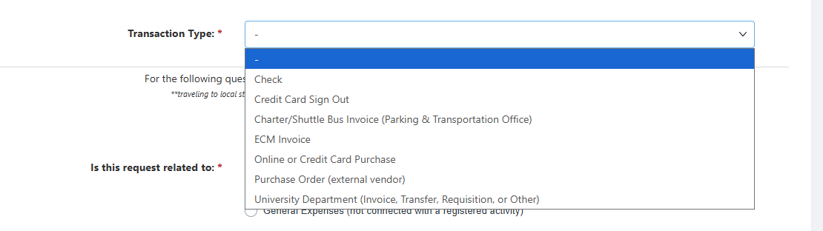
Transaction Type -- Facilities, ECM, Catering, Sanitarian, etc.
Financial Transaction Request Training Business Manager Training 2026
Notes:
These are the other Transaction Types available on the FTR in the drop-down Menu. They are all fairly self-explanatory in what they are asking.

Slide 21
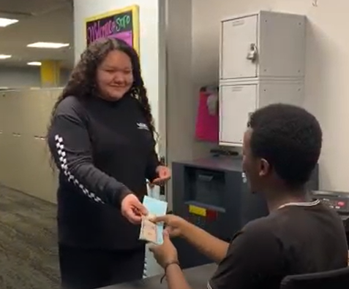
Deposit Drop-off
Deposits must be handed to and verified by a SOFO employee.
A Blue Deposit ticket must be attached to the items being deposited.
Only 1 deposit slip is needed if all items are being deposited to the same “account”.
If you would like separate entries for the items on your monthly report, you should fill out 1 deposit ticket per item.
***Do NOT sign the back of the check***
Financial Transaction Request Training Business Manager Training 2026
Notes:
If you have any money to deposit into your student organization account, all deposits must be handed to and verified by a SOFO employee.
A Blue Deposit ticket must be attached to the items being deposited, and can be found in SOFO when you drop off the deposit.
Only 1 deposit slip is needed if all items are being deposited to the same “account”.
If you would like separate entries for the items on your monthly report, you should fill out 1 deposit ticket per item.
All checks should be written out to the University of Rochester. The name of the Organization can be included in the memo line. It is important that the Source of funds be indicated on the BLUE deposit slip, and a detailed description be provided, as that information is what will appear on your monthly report.
ALL CASH collected at the Shops @ Wilco should be deposited in SOFO as soon as your fundraiser is over! If SOFO is not open when your shops event is concluding, you need to contact the building manager to let you into SOFO to deposit the funds into the safe. There are deposit tickets in the Cash Box from Shops @ Wilco. This is the only exception for handing your deposit to a SOFO employee – building manager. Cash should never be left unattended.

Slide 22
What is next?
Watch the Training Video on Filling out the Financial Transaction Request (FTR) Form (located at sa.rochester.edu)
Take the Business Manager quiz located at sa.rochester.edu. You just need to PASS. Don’t worry about the actual score.
Familiarize yourself with your SA Approved budget and your assigned student accountant (can be located at sa.rochester.edu)
Have a great year!!
Financial Transaction Request Training Business Manager Training 2026
Notes:
Kahoot!!
Score a 75% or higher on the Business Manager quiz – AGAIN, don’t worry about the points that are scored, you only need to know if you PASSED !

Slide 23
Questions?
Meet your SOFO Student Accountant
And Student Activities Staff !!

