Slide 1
SAAC Budget Training

Slide 2
Presentation Timeline
Budgeting Overview
How to Submit a Budget on CCC
Important Budgeting Guidelines
Budgeting Guidelines by Category (Breakout Sessions)

Slide 3
Steps for Business Managers
Attend SAAC Budget Training – You’re here!
Submit Budget by Deadline
Budgets Open: February 3rd
Budget Submission: March 1st at 7:00 pm
March 24th: SAAC Notification of Approved Budgets to Organizations
March 31st: Deadline for Student Organizations to Appeal Budget
April 4th & 11th: SAAC Budget Appeal Hearings

Slide 4
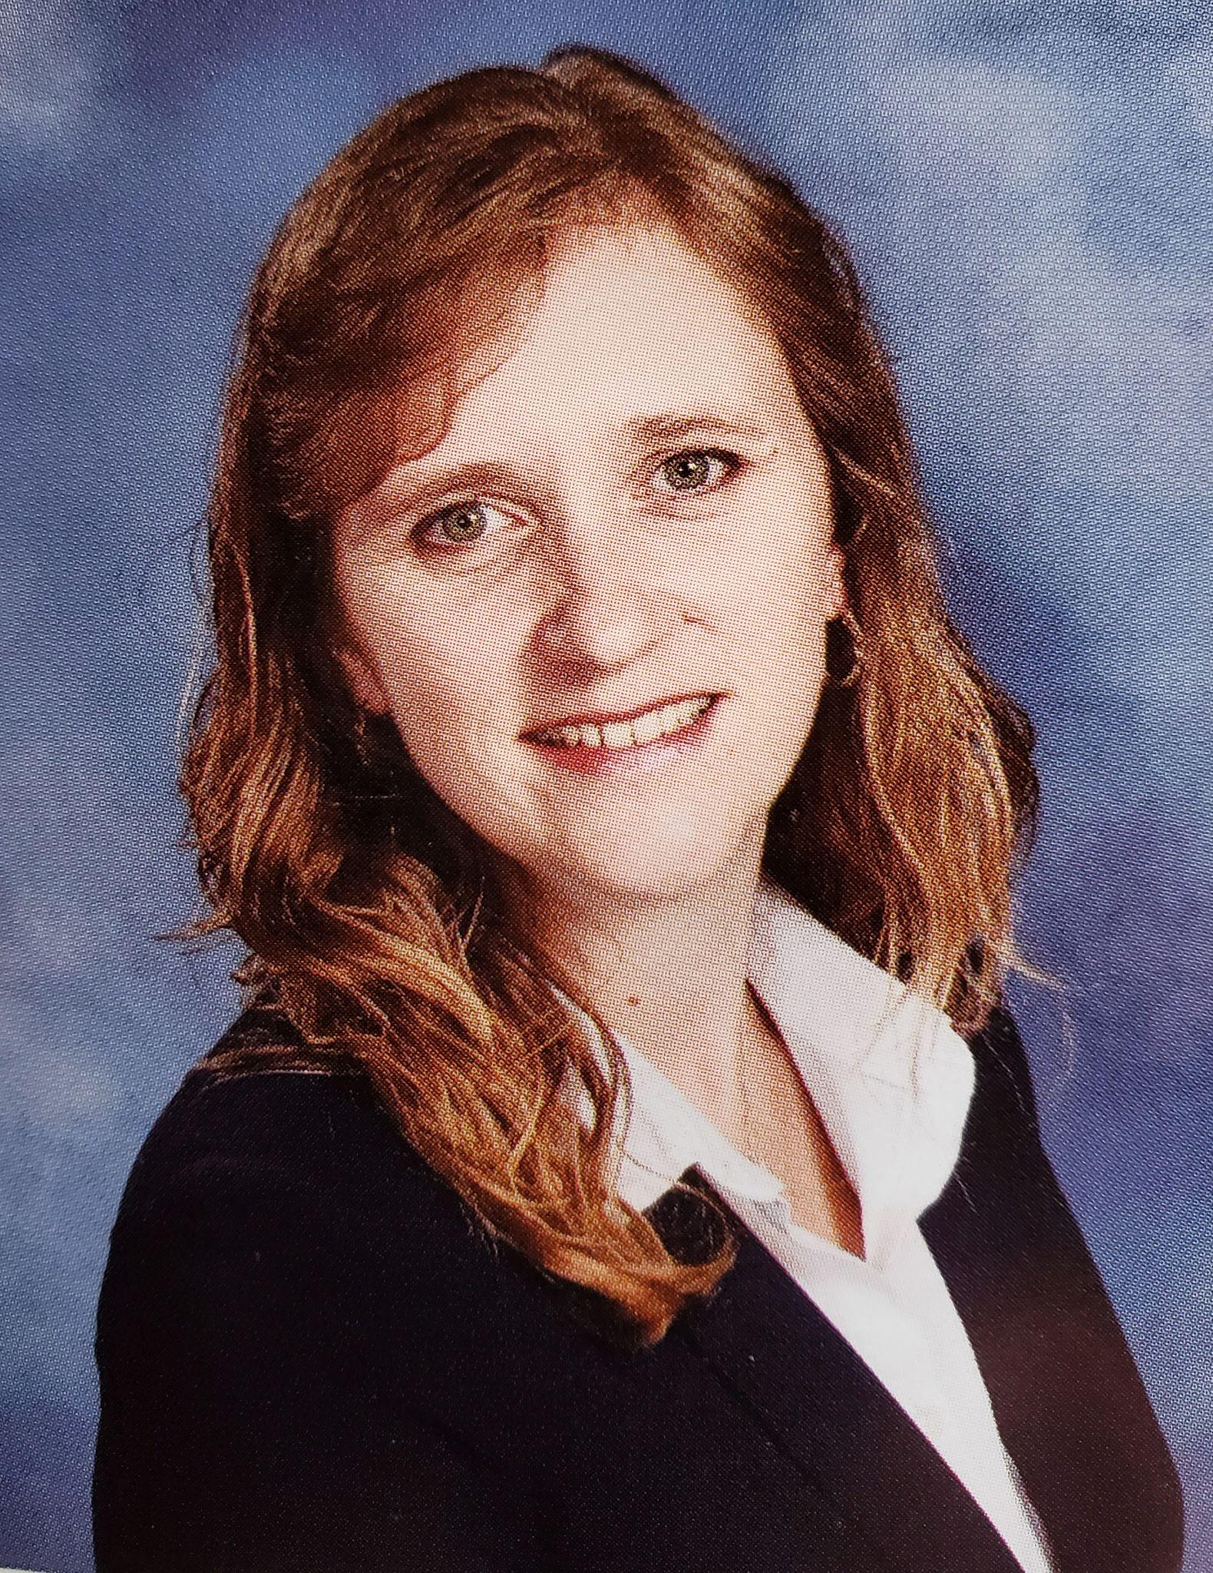
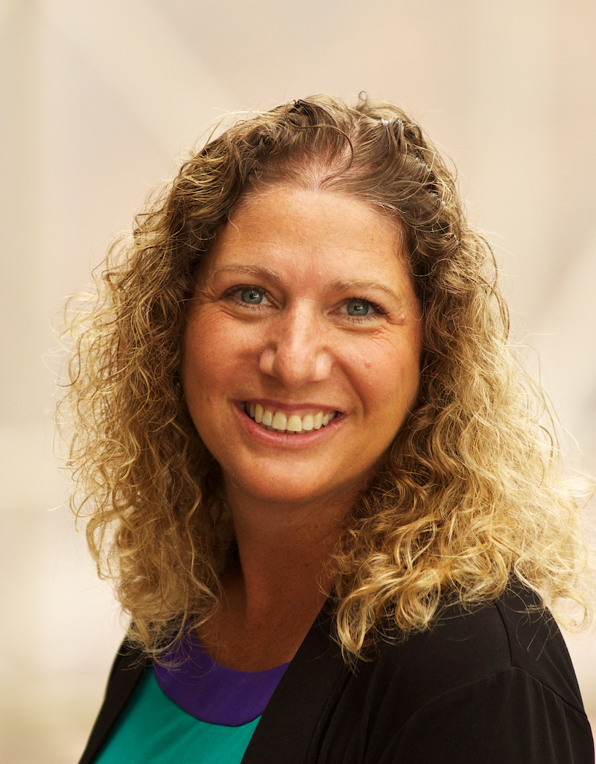
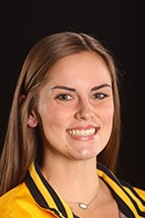
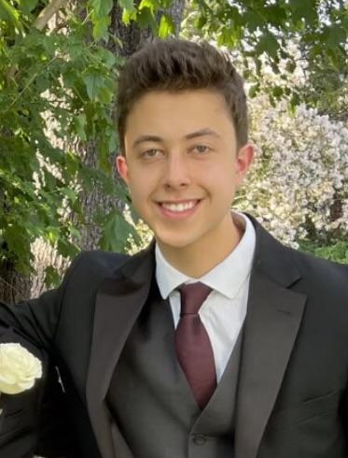
SAAC Leadership
Tina Muller
Manager of Finance
Anne-Marie Algier
Associate Dean of Students & Director of Student Activities
Marissa Carlson ‘24
Treasurer
Potter Flynn ‘25
Deputy Treasurer

Slide 5
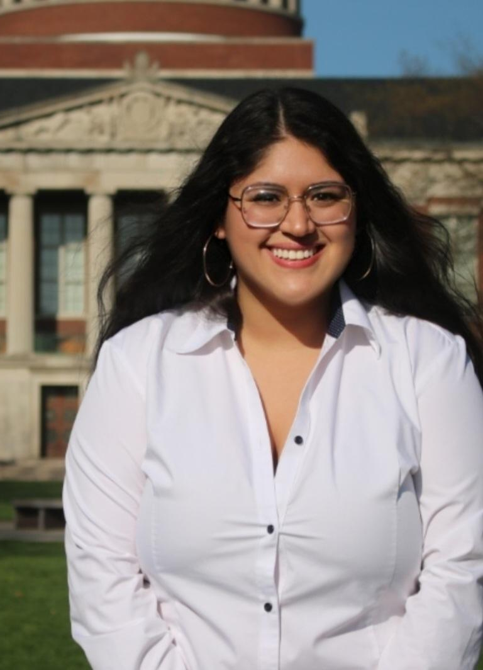
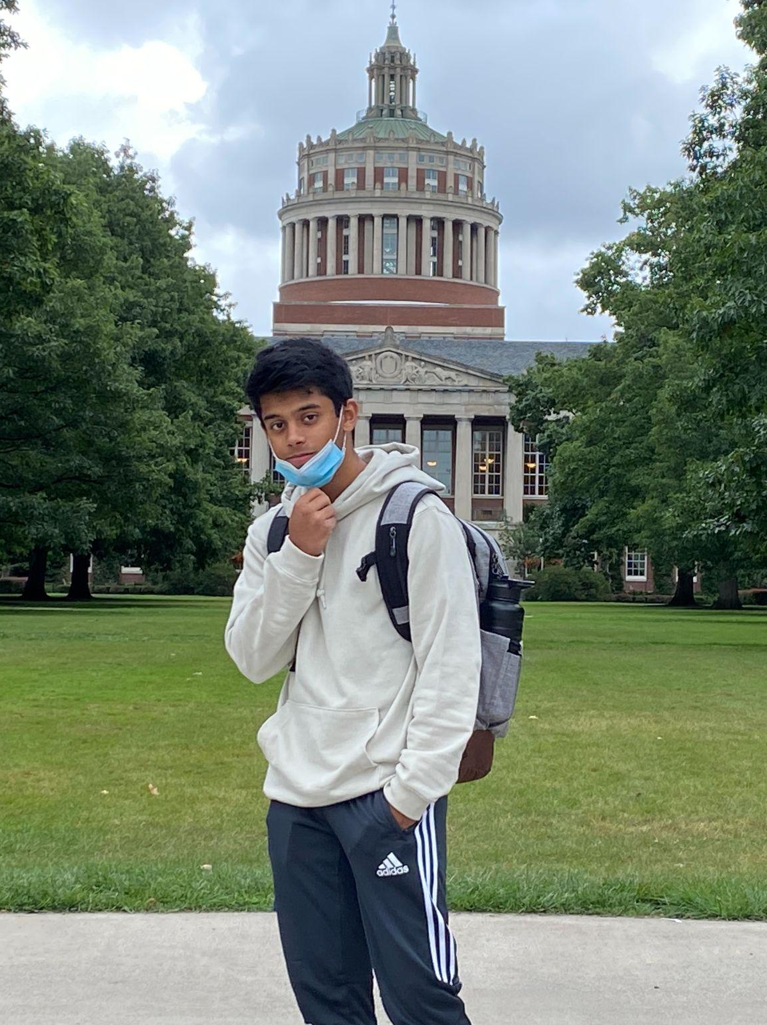
Your Student Accountants
Giovana Flores ‘23
Performing Arts, Political
Potter Flynn ‘25
Academic/Professional, Visual Arts
Lisbeth Hernandez ‘24
Community Engagement
Joshua Jones ‘25
Hobbies & Interests, Religious & Spiritual Life

Slide 6
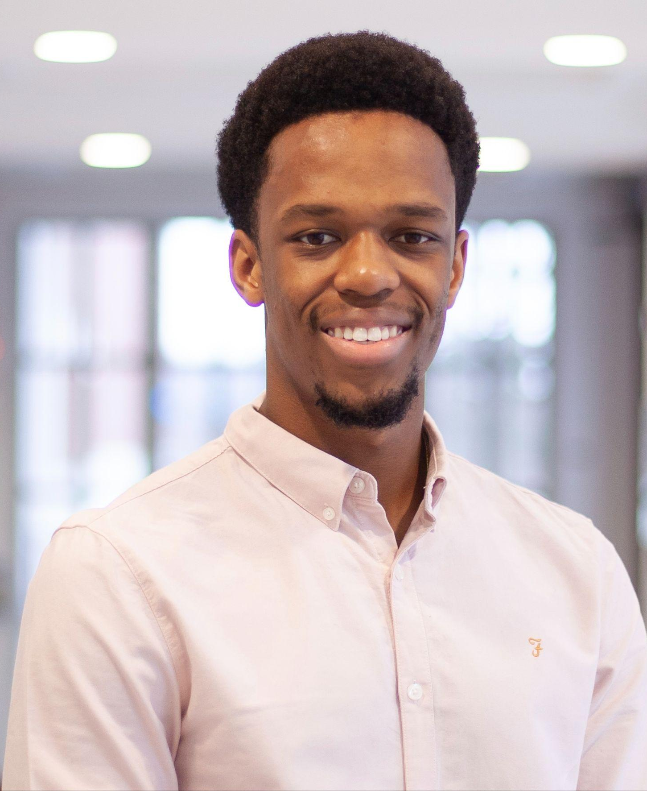
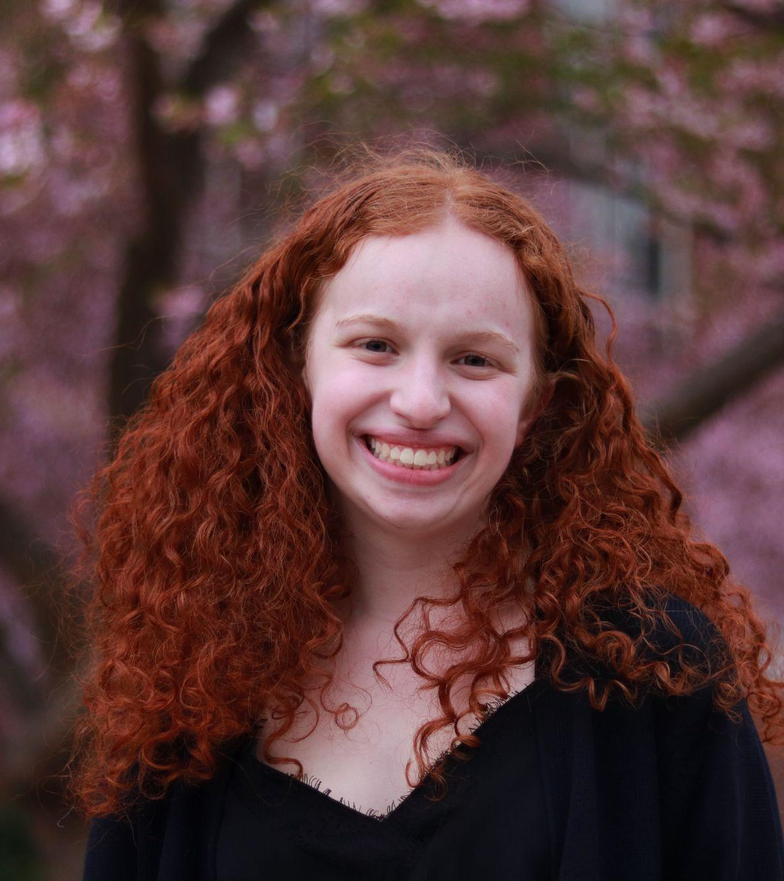
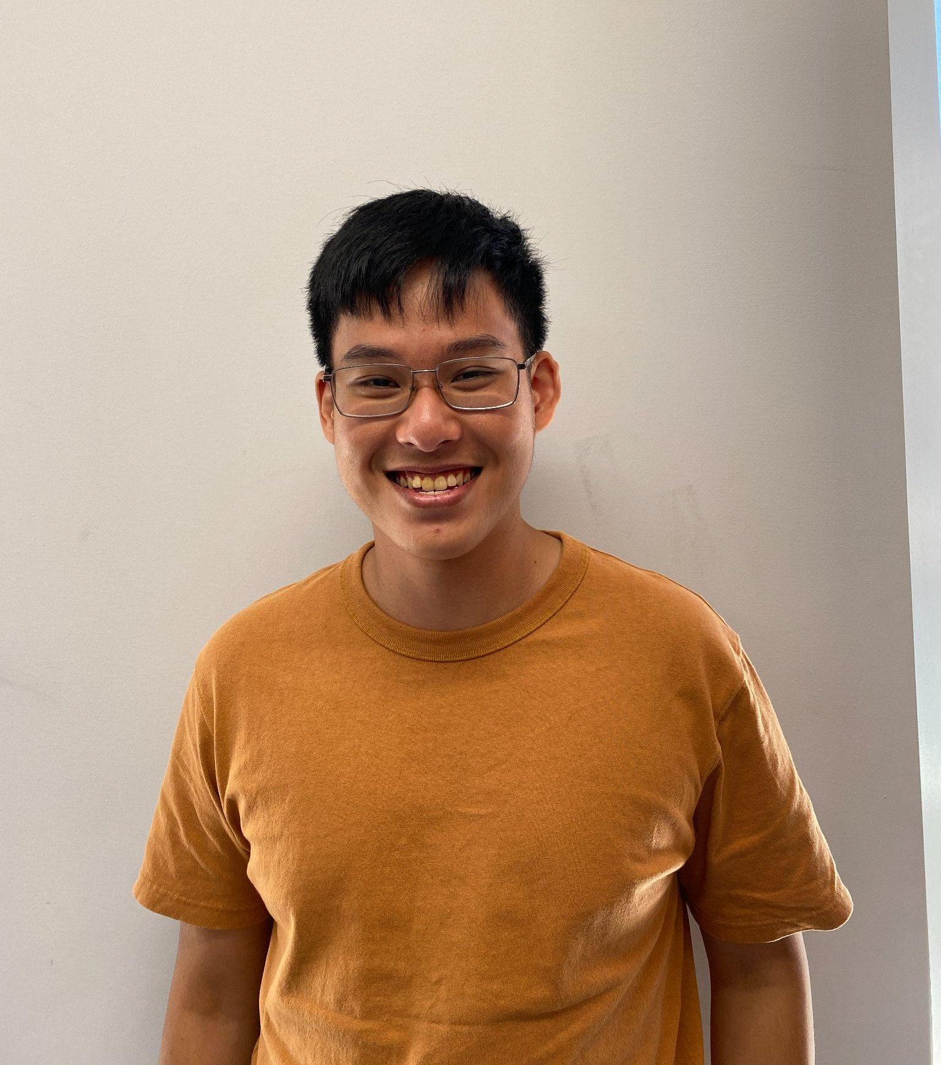
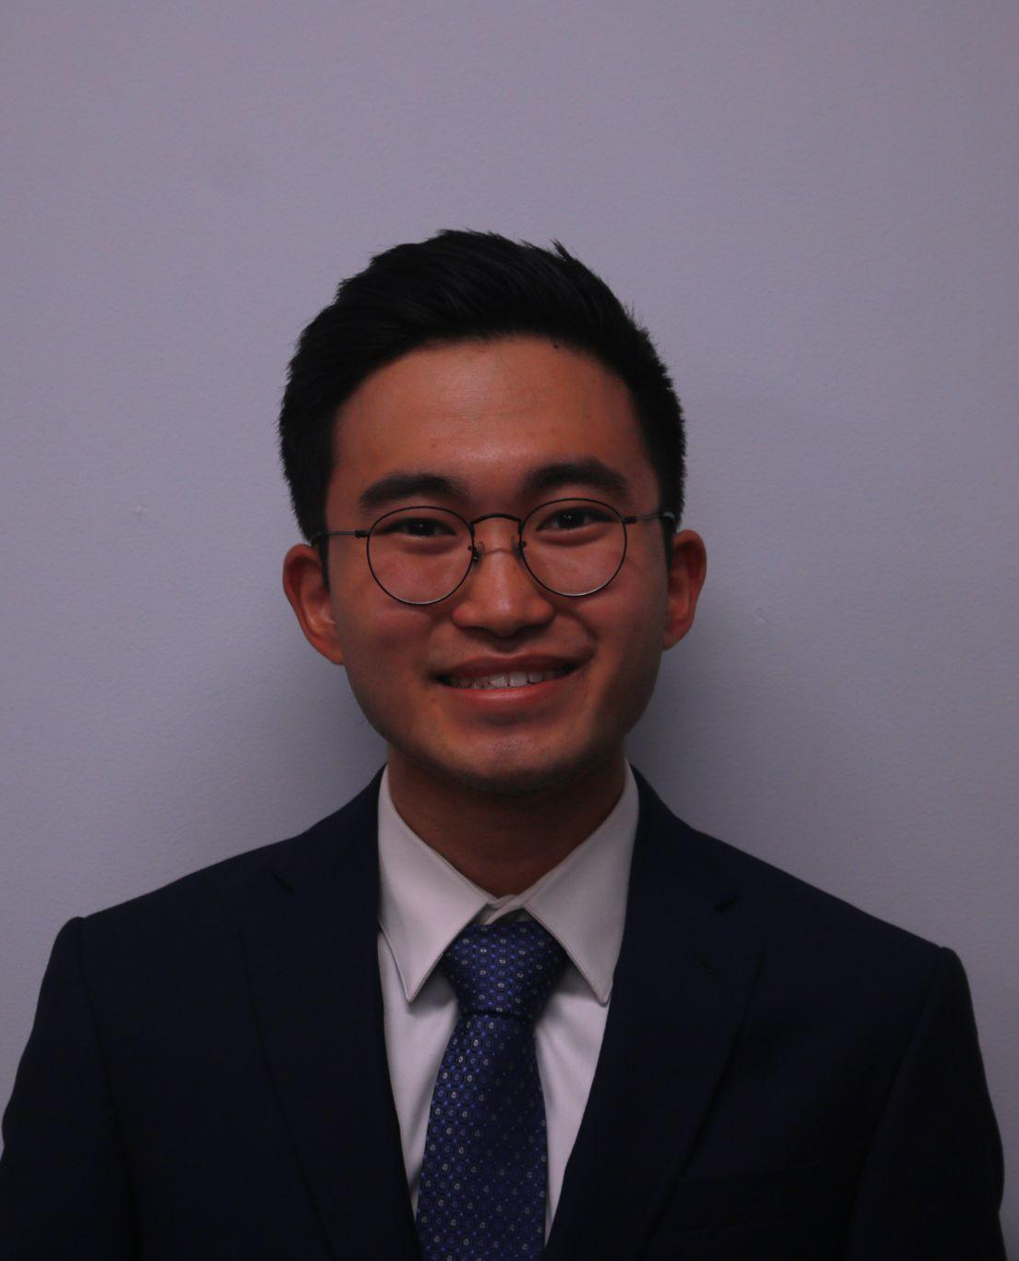
Your Student Accountants
Murimi Kanyogo ‘23
Club Sports
Madison King ’25
Cultural/Identity Based
Quoc (John) Duy Nguyen ‘25
Intercollegiate Competition, Media/Publication
Cole Okuno ‘23
Awareness, Honor Society, Programming

Slide 7
Budgeting Process
2022-2023 Academic Year
Budgeting Period NOW
2023-2024 Academic Year
Your Organization
Your Organization
SAAC Committee
Decision
Appeals
SAAC Committee
*Everything in red is optional

Slide 8
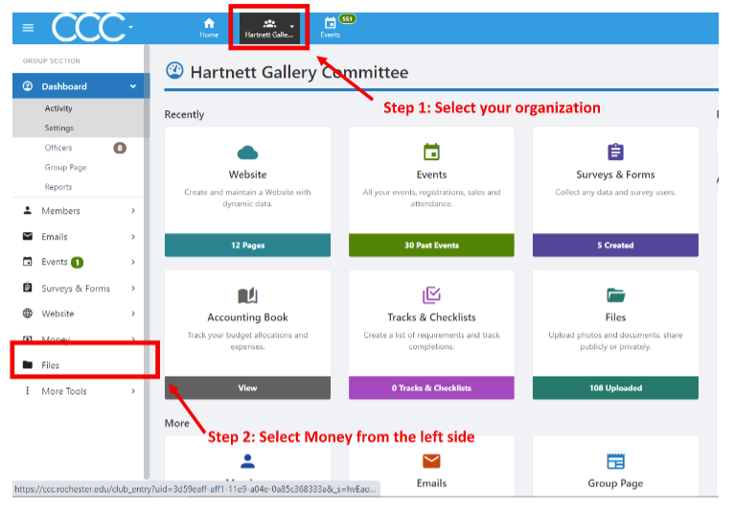
Budget Submission Process
Step 1: Select the student organization that you are the business manager of and will be submitting a budget for:

Slide 9
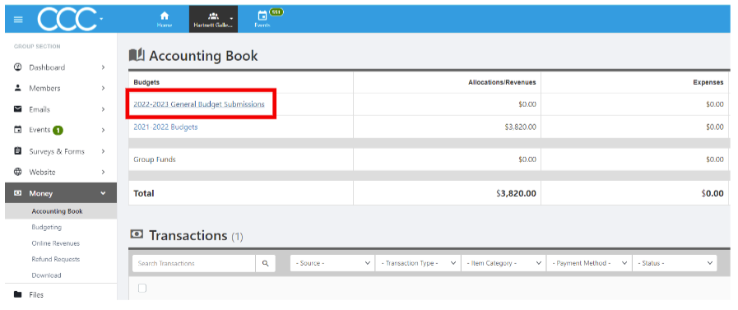
Step 2: Under the ‘Money Module’ drop down, select ‘Accounting Book’ and select the budget that you would like to submit line items for.
*Your ‘Accounting Book’ will look different based on the budget type that your group is eligible to submit

Slide 10
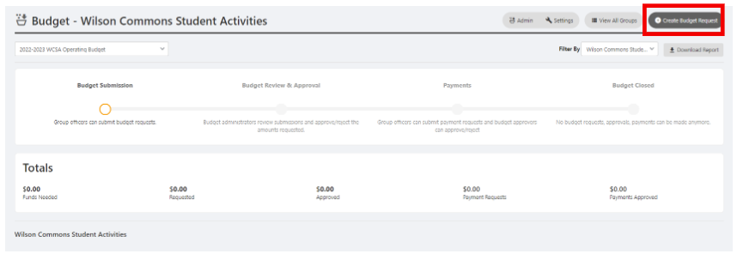
Step 3: Insert budget request by selecting “Create Budget Request”
*You should create a new budget request for each event/activity.

Slide 11
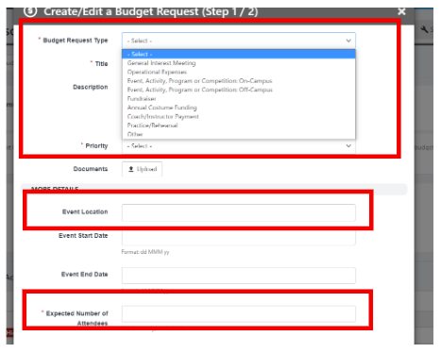
Step 4: Complete step one of the ‘Create/Edit a Budget Request’ by:
1. Selecting the appropriate budget request type
o General Interest Meeting
o Operational Expenses
o Event, Activity, Program or Competition – On-Campus
o Event, Activity, Program or Competition – Off-Campus
o Fundraiser
o Annual Costume funding
o Coach/Instructor Payment
o Practice/Rehearsal
o Other
2. Providing a Title/Name for the budget item
3. Indicating the funding priority (Low, Medium, High)
4. Providing event location
5. Providing the expected/approximate number of attendees

Slide 12
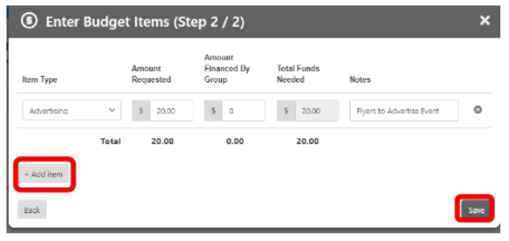
Step 5: Complete step two of the ‘Create/Edit a Budget Request’ by:
1. Selecting your “Item Type”
2. Funding details: amount requested (from SAAC) + amount financed by group (funding that will be earned via ticket sales, co-sponsorships, etc.) = Total Funds Needed (this field auto populates)
3. If there is more than one expense for this budget item, select the “+ Add item” button to add additional line items.
4. Once all expenses have been recorded, select save.

Slide 13
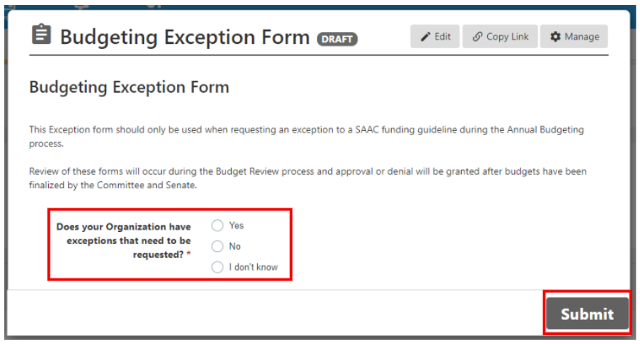
Step 6a: After clicking save, a budget exception form will pop up for each Entry:
*If you have included a budget item that is not permitted per the SAAC funding guidelines, you must select YES at this step.

Slide 14
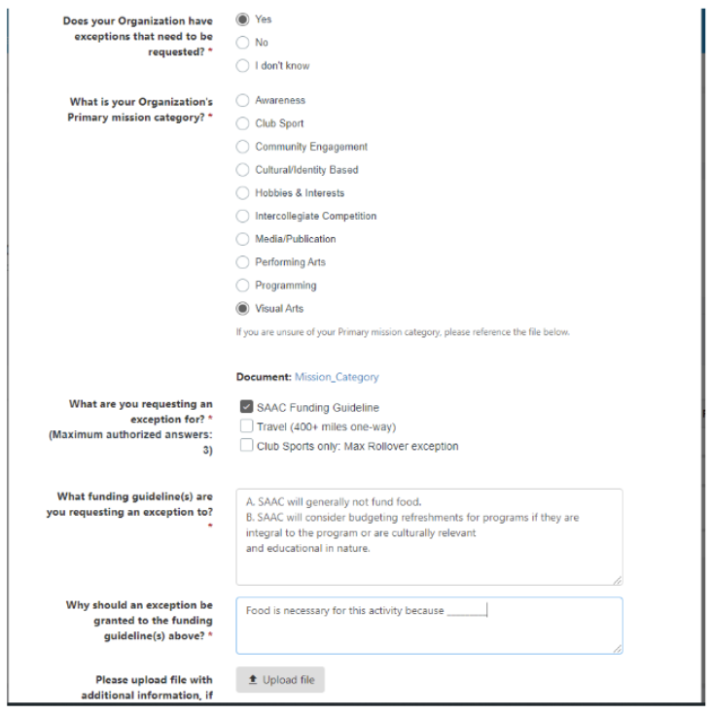
Step 6b: If you have selected “Yes”, you will need to provide:
1. Your organization’s primary mission category
2. Exception Type requested:
a. SAAC funding guideline
b. Travel outside of academic year
3. Specific funding policy that you need an exception to
4. Justification to warrant approval of exception request
*Exceptions must be filled out every year even if it was approved in the past

Slide 15
How are Budgets Evaluated?
Budgeting Guidelines
Overall SOAR Grade/Resource Agreements
Advisor Feedback
Completion of Activity Reflection Forms
SAAC Accountant Feedback
SOFO Feedback
Storage Assessments

Slide 16
Funding Principles
General Funding Principles
Rules you need to follow
Funding Principles by Group

Slide 17
General Funding Guidelines
for ALL Student Organizations
$100 will automatically be allocated for each Organization for General Interest Meetings (GIM)
Funded activities must occur while classes are in session
Funded activities must be registered on CCC
Travel should be kept within a 400 mile radius of the University
Student Organization’s cannot profit from SA Funding

Slide 18
General Funding Guidelines
for ALL Student Organizations
SAAC will generally not consider funding:
Apparel and giveaways
Testing or certifications for individual members
Bonding programs or private activities for organization members
↳ Including Study Breaks
Food expenses (outside of GIMs)
Charitable donations
Activities or items that violate University policies or federal/local laws
Off-site venue or location fees

Slide 19
Predetermined Rates
Gas should be budgeted at $.25/mile
Advertising materials for fundraising activities up to $25 per event
Advertising materials for programs or events open to the entire undergraduate population up to $50 per event
Sanitarian fee is $30 per event

Slide 20
Predetermined Rates
Maximum of $500 for decorations for entire budget period
ECM labor rates are $16.50/hour with no additional charge for standard equipment
Printing Rates:
Ruth Merrill Printer: B&W $.005/imprint | Color
$.12/imprint
Copy Center: B&W $.10/imprint | Color
$.25/imprint
Public Safety:
Unarmed officer $66.50/hour | Armed officer $68.50/hour
Unarmed supervisor $77.75/hour | Armed supervisor $79.50/hour

Slide 21
Resource Agreements
Located on the WCSA website along with your constitution!

Slide 22
Funding Principles
General Funding Principles
Rules you need to follow
Funding Principles by Group

Slide 23
Questions?
First: Check the funding principles
Second: Reach out to your accountant
asksaac@rochester.edu
Marissa Carlson - mcarls11@u.rochester.edu
Giovana Flores - gflores8@u.rochester.edu
Potter Flynn - pflynn5@u.rochester.edu
Lisbeth Hernandez - lhernan9@u.rochester.edu
Joshua Jones - jjo108@u.rochester.edu
Murimi Kanyogo - mkanyog2@u.rochester.edu
Madison King - mking38@u.rochester.edu
John Nguyen - qnguy12@u.rochester.edu
Cole Okuno - cokuno@u.rochester.edu

